Slide 1

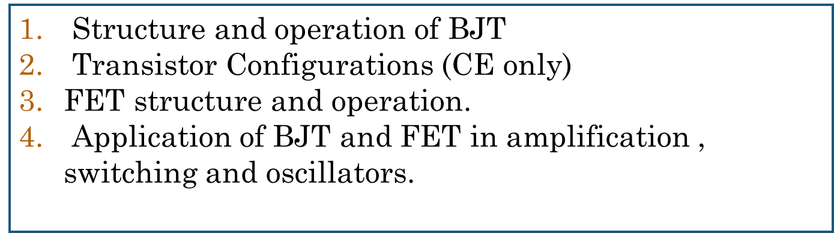
Unit 6
Introduction to transistors
Dr Nirmala K

Slide 2
INTRODUCTION
A bipolar junction transistor (BJT) has three semiconductor layers (emitter, base, and collector) forming two p-n junctions. It is called bipolar device as the current flows due to both electrons and holes. It is called as current controlled device as relies on a small base current to control a larger collector current,thus input base current controls the output collector current (IC=βIB). This control allows the BJT to function as an amplifier or a switch.
A bipolar junction transistor (BJT) is a three-layer active device. There are two types of BJTs:
NPN: An N-type emitter and collector sandwiching a P-type base.
PNP: A P-type emitter and collector sandwiching an N-type base.

Slide 3
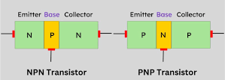
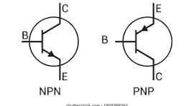
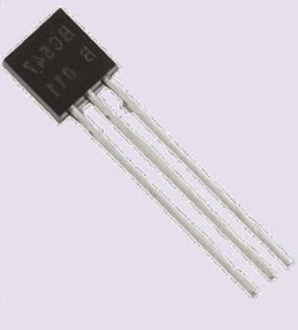
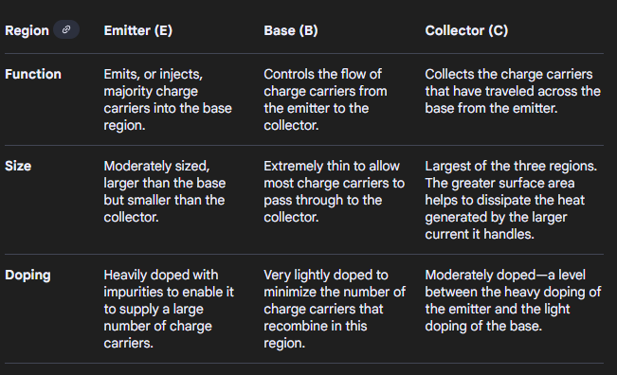
Construction
Construction Symbol Appearance
A BJT has three terminals: the emitter, base, and collector.

Slide 4
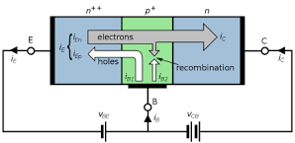
OPERATION
A BJT's operation relies on a small current at the base controlling a larger current between the collector and emitter. By controlling the forward and reverse bias of the two p-n junctions (emitter-base and collector-base), a BJT can amplify signals or act as a switch. Its three modes of operation are cut-off, saturation, and the active region, depending on the voltages applied.
Switching: OFF (Cutoff): When no significant voltage is applied to the base, the transistor is "OFF," acting like an open switch, and no current flows from the collector to the emitter.
ON (Saturation): When a sufficient voltage is applied to the base, the transistor turns "ON," acting like a closed switch. A large current can then flow through the device.
Amplification: A small, varying voltage applied to the base can cause a large, amplified version of that voltage variation to appear across the collector-emitter path.
The ratio of the collector current to the base current is called the current gain, symbolized by beta(β=IC/IB).
Operating Region | Base Emitter junction JBE | Base collector Junction JBC | Operation
Active Region | Forward Bias | Reverse Bias | Amplifier
Saturation Region | Forward Bias | Forward Bias | ON Switch
Cutoff Region | Reverse Bias | Reverse Bias | OFF Switch

Slide 5

When the collector side is open-circuited: In such a case only the emitter current IE flows from emitter to base and to the voltage source V_{EE}.
When the collector side is closed: In such a case recombination occurs in the base creating the recombination current I_{E} minority plus I_{E} majority. Thus:
I_{E} majority when transferred to p-region from the base gets converted to I_{C} majority and the minority carriers due to the open-circuited emitter–base region flow from n-side (base) to p-side (collector).
Hence the current coming out of the collector region:
Meanwhile the recombination current in the close-circuited emitter–base region, which was termed as I_{E} minority, is nothing but the base current I_{B}.
Thus, applying Kirchoff’s current rule in the collector terminal:

Slide 6
Applications of BJT
Amplifier circuits (audio, RF)
Switching circuits (digital logic, driver stages)
Modulators/demodulators & signal processing
Any circuit where control of current or signal amplification is required.
Transistor configurations
The three main configurations of a transistor are Common Base (CB), Common Emitter (CE), and Common Collector (CC), each named after the terminal that is common to both the input and output circuits. The CE configuration is the most widely used due to its high voltage and current gain, while the CB configuration is used for high-frequency applications, and the CC configuration (also known as an emitter follower) is used for impedance matching.

Slide 7
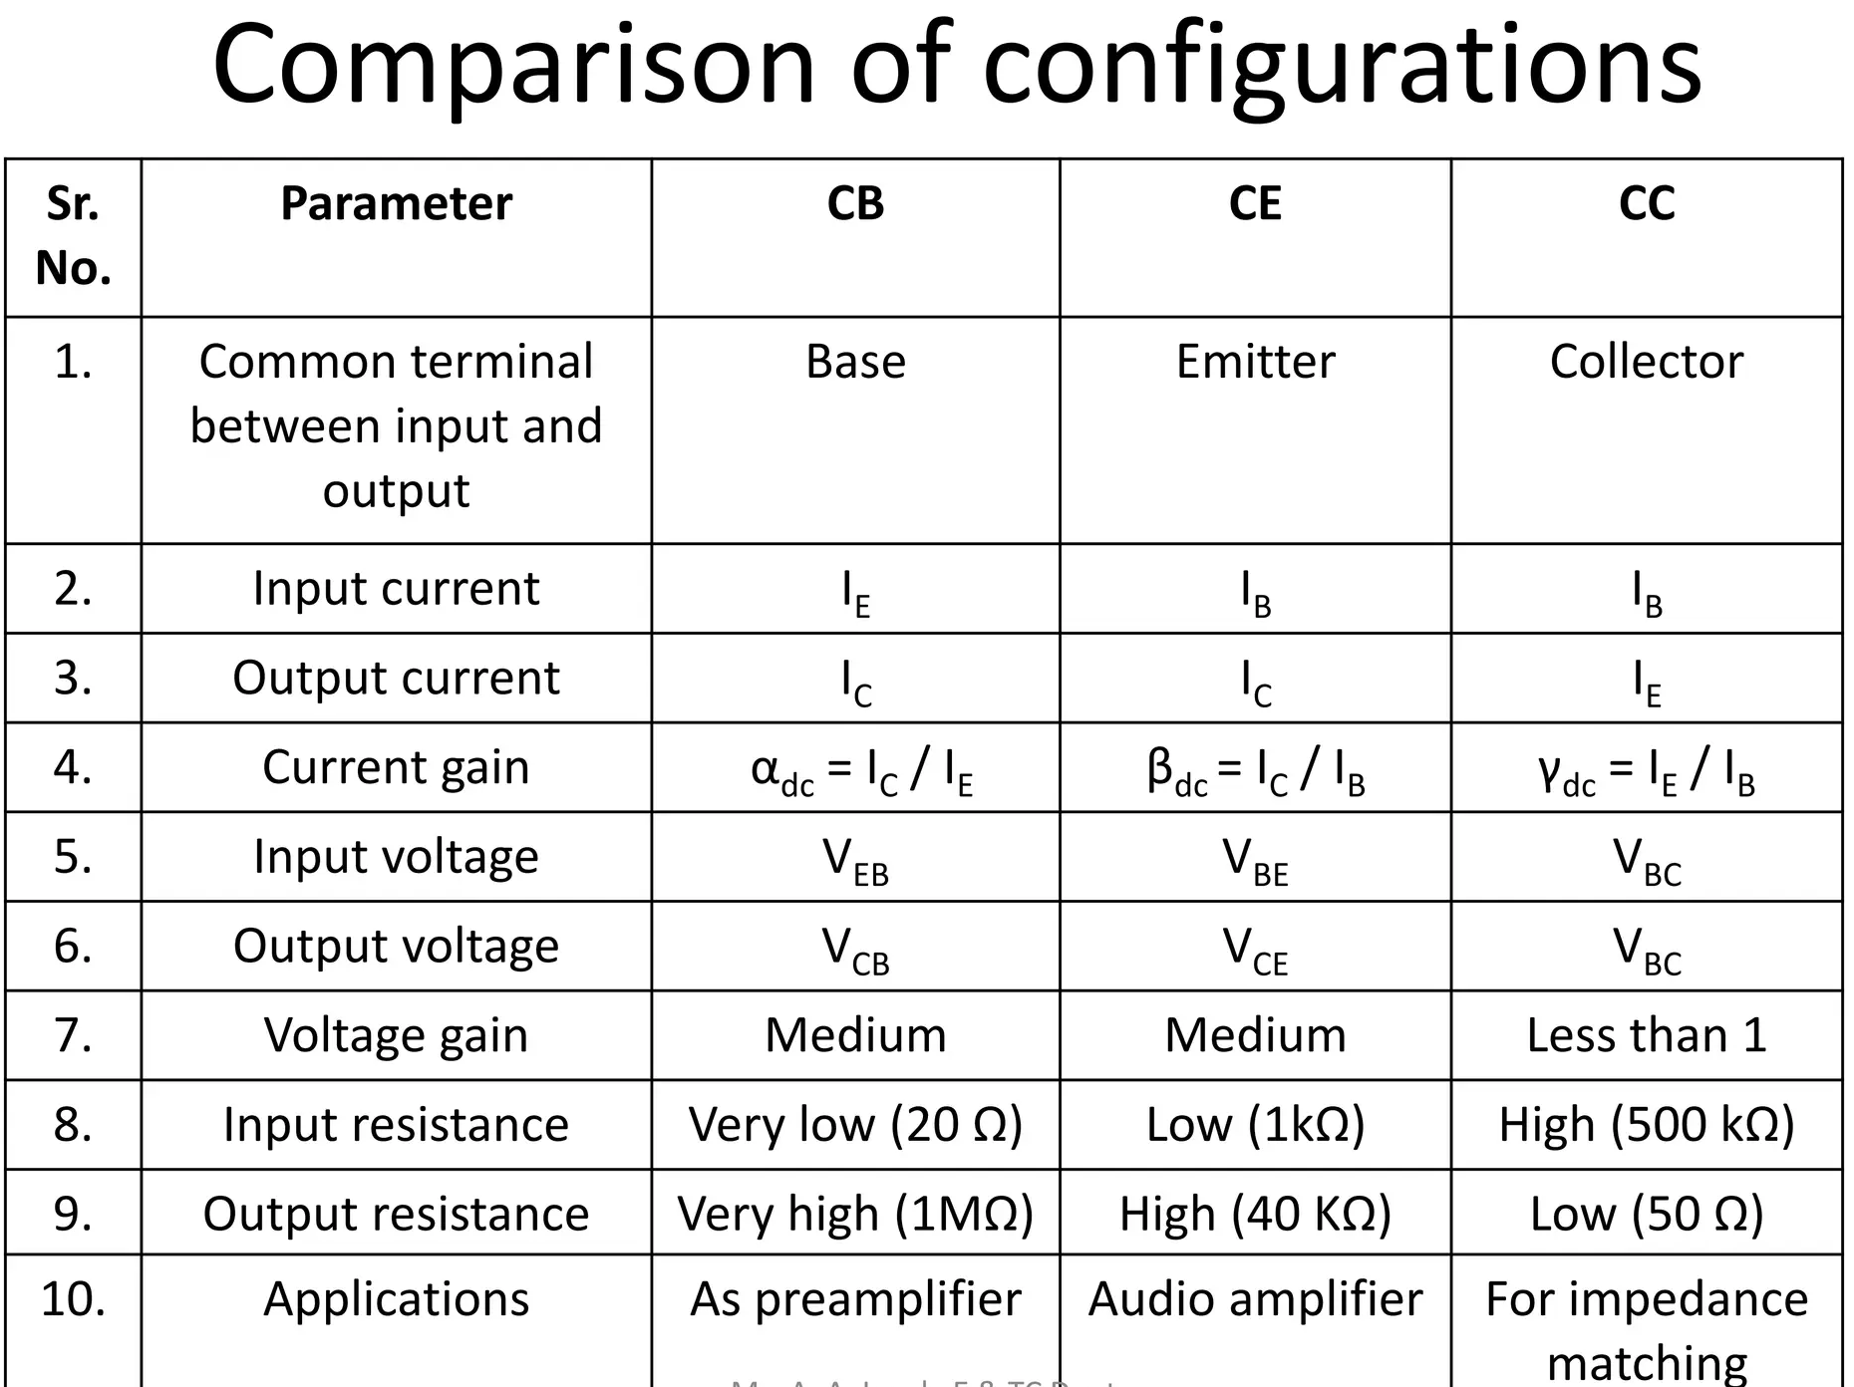

Slide 8
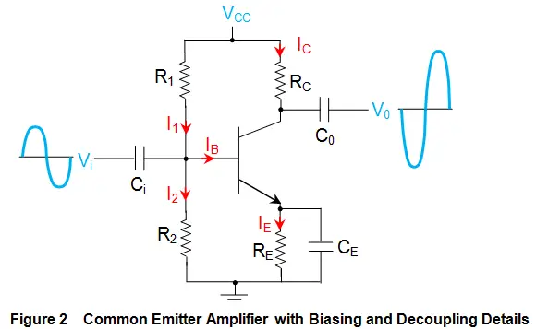
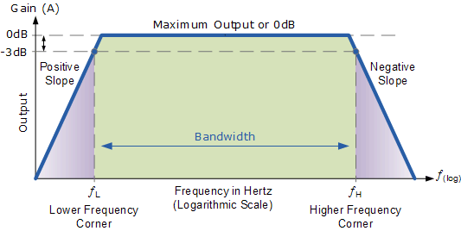
Transistor Configurations (CE only)
CEC Amplifier Frequency Response
The common emitter (CE) configuration is a transistor circuit where the emitter is common to both the input and output circuits. The input signal is applied between the base and emitter, and the output is taken from the collector and emitter.
The CEC is widely used for amplification because it provides a high current gain and high power gain, though it results in a 180-degree phase shift between input and output signals.

Slide 9
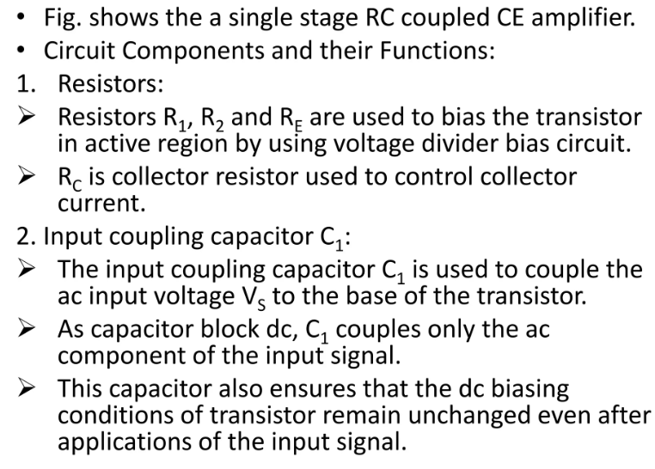
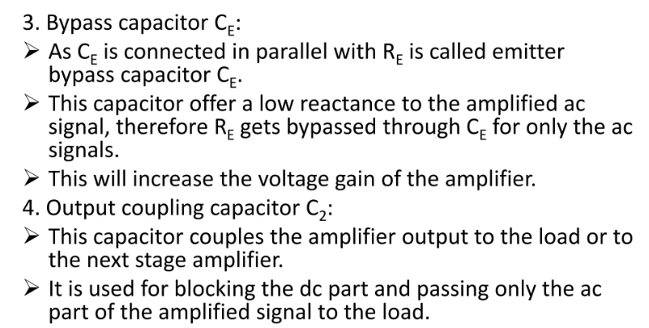

Slide 10
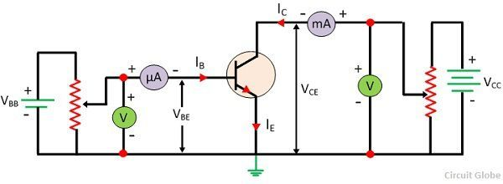
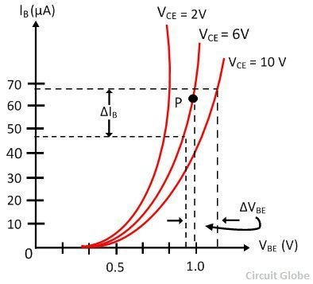
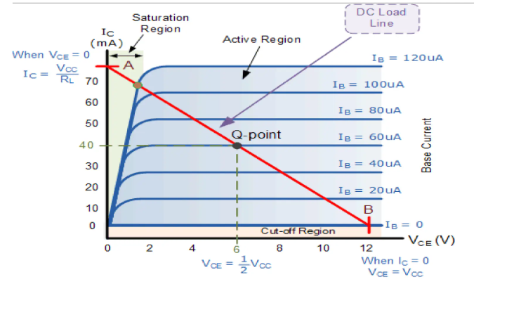
Input and Output Characteristics
CEC practical set up
Input characteristics( VBE VS IB , at VCE constant)
Output characteristics ( VCE VS IC , at IB constant)

Slide 11
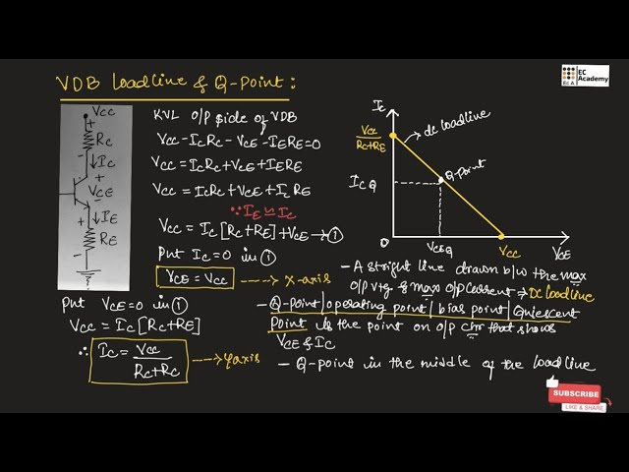
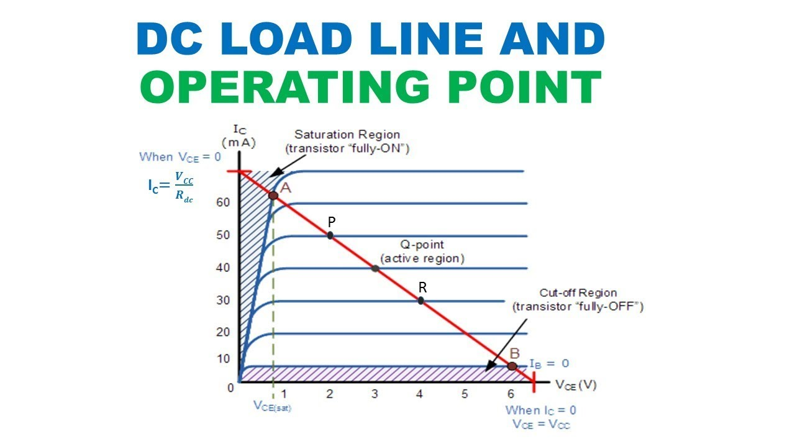
DC load line and Q point (Operating point)

Slide 12
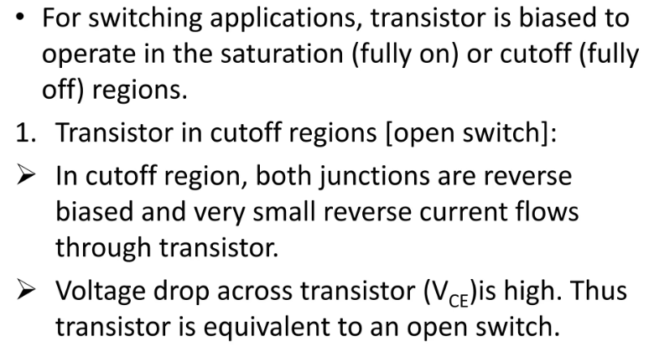
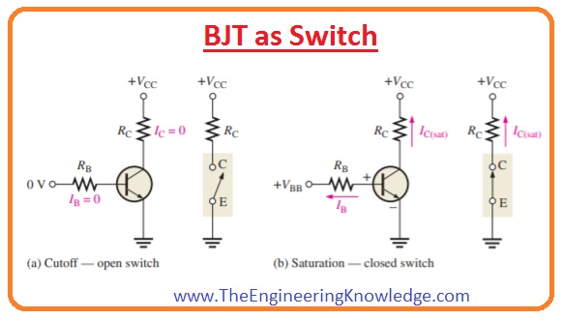
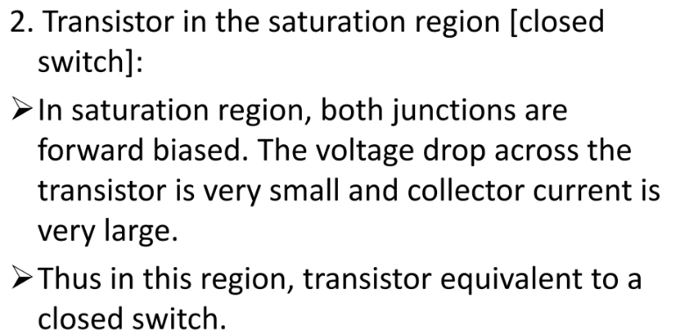
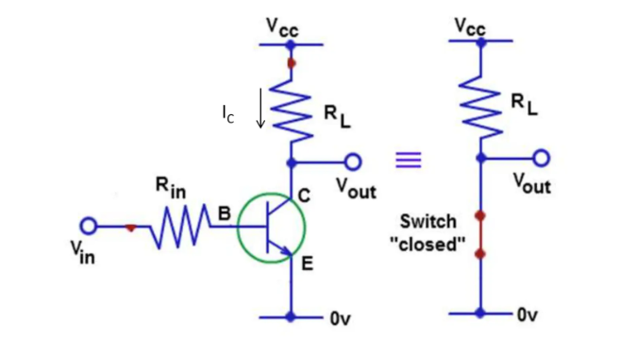
BJT as a Switch

Slide 13
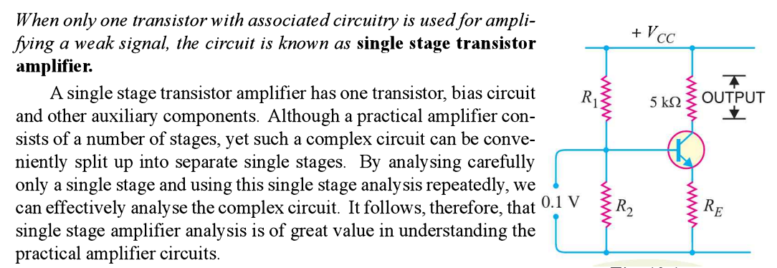
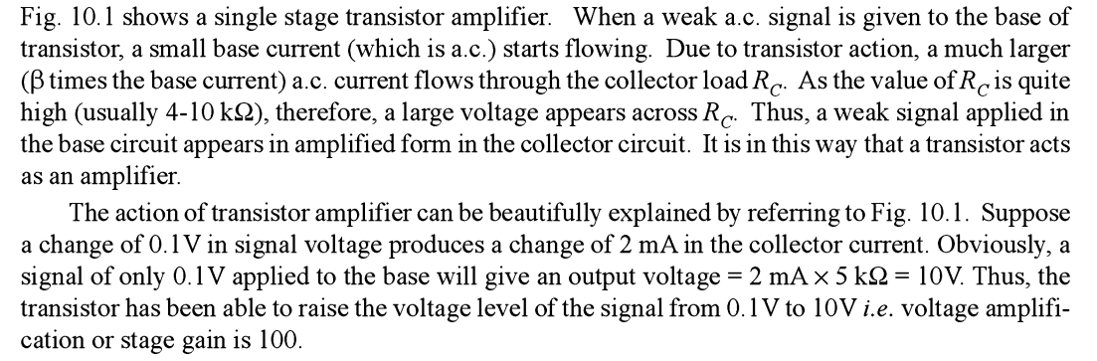

BJT as Amplifier

Slide 14
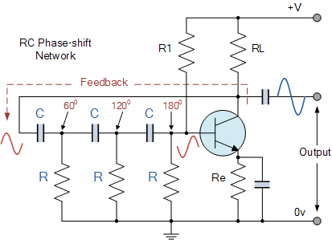

BJT as Oscillator
A Bipolar Junction Transistor (BJT) can be used as an oscillator by combining it with a frequency-selective feedback network, such as a combination of resistors and capacitors (RC) or inductors and capacitors (LC).
The BJT acts as an amplifier, and the feedback network provides a portion of the output signal back to the input (positive feedback).
For sustained oscillation, the feedback signal must meet the Barkhausen’s Criteria-For the circuit to oscillate, two conditions must be met:
1. The total phase shift around the loop must be 360° (or 0°).
2. The loop gain (the product of the amplifier's gain A and the feedback network's gain B) must be at least
(AB≥1).
Amplification: The BJT is configured as a CE amplifier. The input signal at the base is amplified and inverted (180° phase shift) at the collector. Phase Shift Network: The three RC sections are arranged in a ladder or cascaded network. Each section shifts the signal by 60°. Three sections result in a total phase shift of (3*60°=180°). Positive Feedback: The amplified and phase-shifted output from the BJT is fed back to the input through the RC network. The 180° phase shift from the amplifier and the 180° phase shift from the RC network combine to create a 360° total phase shift. Sustained Oscillation: For oscillation to occur, the gain around the loop must be 1 (or greater). The RC network is designed so that at a specific frequency, the magnitude of the loop gain is 1. When the circuit is powered on, random noise acts as the initial signal, and this signal is amplified and fed back, causing the circuit to oscillate at the desired frequency, called frequency of oscillations .
Hz
.

Slide 15
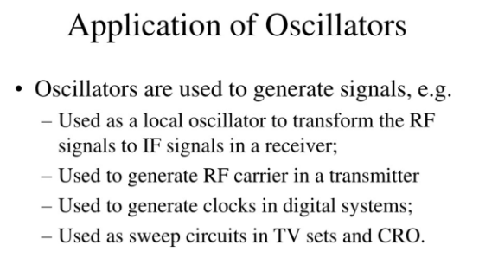
Advantages
Simple and inexpensive circuit.
Eliminates the need for bulky and expensive inductors.
Can be designed for both low and high frequencies.
Disadvantages
Can generate harmonics, leading to distortion.
Frequency stability is not as high as other oscillators, especially when using fewer RC sections.
The gain of the BJT must be precisely set to satisfy the loop gain requirement

Slide 16
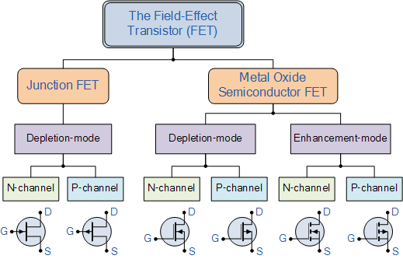
FET-Field Effect Transistor
The field-effect transistor (FET) is a type of transistor that uses an electric field to control the current through a semiconductor. Types-
A Field-Effect Transistor (FET) is called a unipolar device because the current conduction through it is carried by only one type of charge carrier, either electrons (N channel FET) or holes ( P channel FET).
FET is also called a voltage-controlled device because the voltage applied to its gate terminal Vgs controls the output current flowing between the drain and source terminals ID.
(Compare BJT and FET –Covered in class- 7 points )

Slide 17
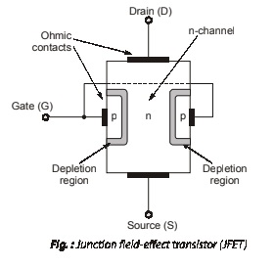
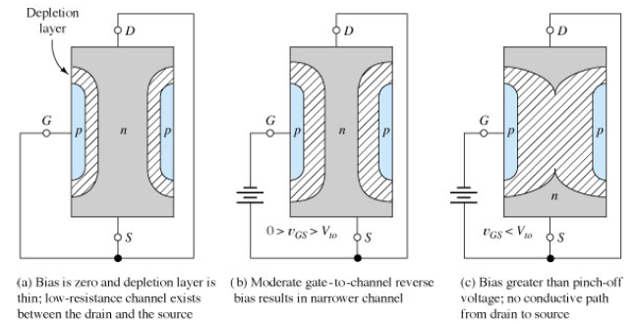
FET Contruction
N channel FET construction consists of a N type semiconductor with P type doping on both the sides (as shown), which are shorted internally to form the gate terminal G.The other two ends of N type semiconductor forms the drain D and Source S terminals.
Thus construction involves a semiconductor channel with a gate electrode that controls current flow between two other terminals, the source and the drain. The gate voltage creates an electric field that modulates the channel's conductivity, acting like a valve to control the flow of electrons or holes between the source and the drain.
By applying a voltage at the gate terminal, the number of charge carriers in the channel can be modulated, leading to a corresponding change in the current flow between the source and the drain terminals.
FET Operation

Slide 18
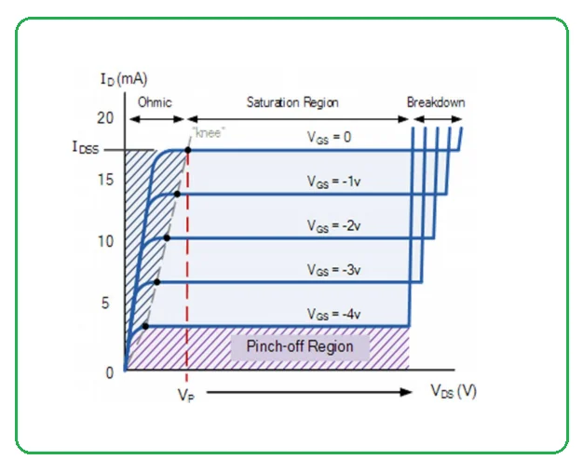
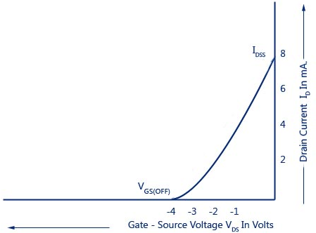
When gate voltage VGS=0 (connected to the source, or left unconnected) , and drain to source voltage is varies in steps , current ID increases. This causes the FET to behave like a voltage-controlled resistor in its ohmic region (Graph for VGS=0)- fig a.
When a voltage is applied to the gate electrode(fig b) , an electric field is created across the insulating layer, which in turn creates a depletion region in the channel. The depletion region reduces the number of free charge carriers in the channel, and thus the conductivity of the channel is reduced. This effect is known as the field-effect, and it is the basis of the FET operation. In the case of an n-type FET, a negative voltage applied to the gate electrode creates a depletion region in the channel, which reduces the flow of electrons from the source to the drain. (In contrast, a positive voltage applied to the gate electrode of a p-type FET creates a depletion region that reduces the flow of holes from the source to the drain).For gate voltage more than pinchoff voltage, the depletion regions will be too wide , touching from both ends, reducing channel length to zero , current becomes zero (fig c).
Thus, by varying the voltage applied to the gate electrode, the conductivity of the channel can be controlled, and the flow of current through the FET can be modulated.
Transfer characteristics
Drain / V-I characteristics

Slide 19
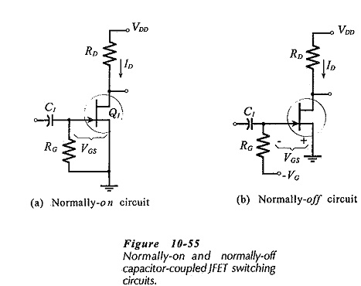
FET AS a Switch
FET acts as an electronic switch by using a voltage at the gate to control the flow of current between the source and drain. When a control voltage is applied, the FET can be turned on (closed switch) or off (open switch) by biasing its gate into the linear/ohmic or cutoff regions, respectively. This makes FETs useful for controlling analog signals with high on-resistance and low off-resistance.
Switch ON state: A zero gate voltage applied to the gate to allow current to flow between the source and drain. The FET acts as a closed switch with low on-resistance, fig a.
Switch OFF state: When negative gate voltage is applied to the gate, the FET blocks current from flowing and acts as an open switch with high resistance, fig b.

Slide 20
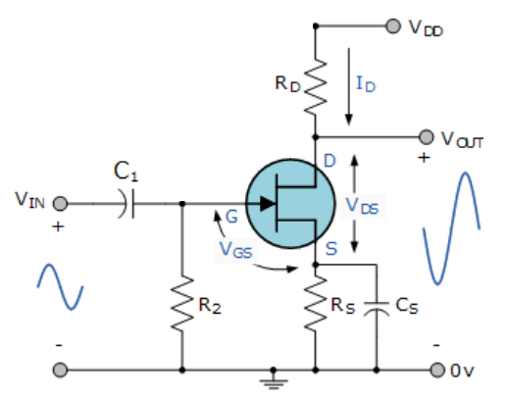
Advantages of using FETs as switches
1. They are High input impedance: FETs are voltage-controlled devices, so very little current is required
at the gate to turn them on or off.
2. Low on-resistance: When fully on, the resistance between the source and drain can be very low,
allowing for efficient current flow.
3. High off-resistance: When off, the resistance is extremely high, preventing current leakage.
4. Speed: FET switches can operate at very high speeds, with switching times as low as a few
nanoseconds with proper driver circuits.
5. Low power: energy-efficient and have low leakage currents.
A field-effect transistor (FET) is used as an amplifier to increase the strength of a signal by controlling
the current between the drain and source terminals with the voltage at the gate. FET amplifiers are
known for their high input impedance, low power consumption, and ability to provide high voltage gain.
FET AS AMPLIFIER

Slide 21
When the input signal is applied through the capacitor C1 to the gate terminal. This capacitor is used to determine whether the gate terminal is affected by any DC voltage from the previous stage. The potential is held by the resistor R2 of around 1Mega ohms located between the gate and the ground. The voltage is generated across the resistor R2, which keeps the source above ground. The bypass capacitor C2 adds gain to the alternating current signal.
The amplified output voltage is obtained by crossing the resistor R3 at the load at the circuit’s drain terminal. The capacitor C3 couples the amplified output voltage to the AC signal of the next stage by blocking or eliminating the DC components. This amplifier’s amplified output signal is 180 degrees out of phase concerning the input signal and produces a high power gain.
There will be no current flowing between the gate and the source in the reverse-biased state. As a result, the gate current is zero. The gate voltage (DC) is then given as.
Vg = Ig x Rg
The DC voltage at the source is given by,
Vs = Id x Rs
Then the gate to source voltage is given by,Vgs = Vg – Vs = 0- Id x RsSince Ig = 0
Vgs = – Id x Rs
Where,
Vgs = gate-source voltage
Vg = gate voltage
Rs = resistor at the source
Rg = resistor at Gate
Ig = gate current
The flow of DC components in the drain current can cause the resistor Rs to self-bias and provide feedback from the output to the input.

Slide 22
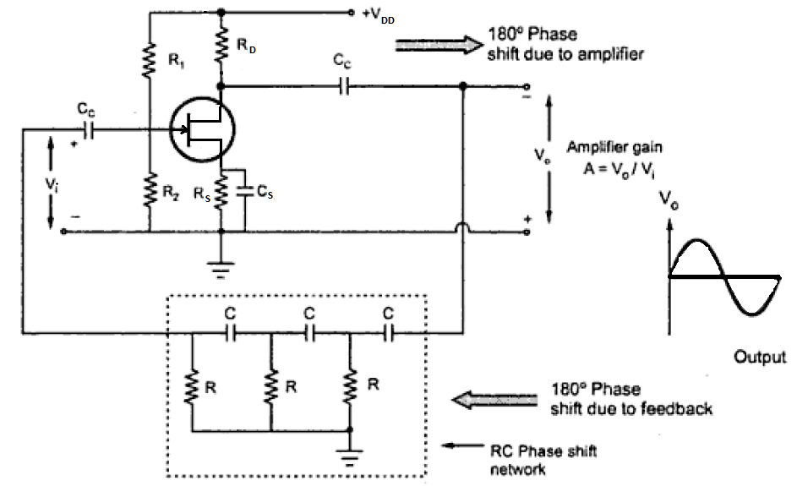
Applications of FET Common Source Amplifier Circuit
Used in sensor signal amplification.
RF signal amplification with low noise.
Used in communication systems such as television and FM receivers.
In op-amps, they are used as voltage-controlled devices.
Cascade amplifiers and RF amplifier circuits are examples of their applications.
A Field-Effect Transistor (FET) serves as the amplifier in an RC phase shift oscillator, which
uses a series of three RC networks to provide a feedback signal that is phase-shifted by 180
degrees. The common-source FET amplifier provides an additional 180-degree phase shift, resulting
in a total 360-degree shift required for sustained oscillations.
FET as Oscillator

Slide 23

The FET is configured as a common-source amplifier, which is an inverting amplifier. This provides a 180-degree phase shift between the input signal at the gate and the output signal at the drain.
RC feedback network: The output signal is fed back to the input gate through a three-stage RC network. Each RC section is designed to provide a 60-degree phase shift at the desired frequency of oscillation.
Total phase shift: The three RC stages combined provide a total of 180 degrees of phase shift (3*60°=180°).
Oscillation condition: For oscillation to occur, the total phase shift around the loop must be 360°/0°.
In this circuit, the 180°phase shift from the amplifier and the 180°phase shift from the RC network combine to meet this condition.
Feedback and gain: The Barkhausen criterion states that the magnitude of the loop gain (A* β) must be at least 1 for oscillations to start. In a FET phase shift oscillator, the required amplifier gain (A) is at least 29 because the feedback network attenuates the signal by a factor of 1/29.
Oscillation frequency: The frequency of oscillation is determined by the values of the resistors (R) and capacitors (C) in the feedback network and is given by the formula:
Output: The output is a sinusoidal waveform, typically in the low audio frequency range, making it suitable for audio applicaions
Applications of FET as RC phase shift oscillators
1. Audio and signal generation: They are used to create a wide range of frequencies in the audio spectrum, from
a few Hz to 200 kHz.
2. Musical instruments and voice synthesis: The generated audio frequencies are useful for creating sounds in
electronic music and for voice generation systems.
3. Signal generators: They are used to generate sine wave signals for various audio and RF applications.
4.Tone generators: They can be employed in audio circuits to produce specific tones.
5. Test equipment: These circuits are valuable in laboratories for testing other electronic circuits.

Slide 24
Questions
Explain construction of BJT with neat sketch.
Explain BJT as a switch with neat sketch.
Draw and explain BJT as Oscillator with neat diagram. State the formula for resonance frequency.
Sketch the practical set up to plot characteristics of CE configuration & draw the Input -output characteristics of CE configuration.
Explain with neat sketch the working of BJT transistor an amplifier.
Explain with neat sketch FET as oscillator .(OR Sketch FET as phase shift oscillator, explain in brief.)
Compare BJT and FET. (6 points)
Draw and explain constructional diagram for N- channel FET.
Write short note on FET.
Draw and explain FET as a switch.
Give reason , FET is called as voltage controlled device and BJT is called as Current controlled device.
Give reason , FET is called as unipolar device and BJT is called as bipolar device.

